Slide 1

Deep Learning for Text Recognition: An Overview
This presentation explores the exciting advancements in text recognition. We'll focus on how deep learning has revolutionized the field. Get ready to dive into architectures, techniques, and real-world applications.

Slide 2
The Evolution of Text Recognition Techniques
From basic pattern matching to advanced neural networks, we will see significant progress. Early methods struggled with variability. Deep learning offers robustness to noise and distortions.
Early Methods
Machine Learning Era
Deep Learning Revolution
Simple template matching and feature extraction. Limited in handling variations.
Support Vector Machines (SVMs) and Random Forests. Improved but still had limitations.
Convolutional Neural Networks (CNNs) and Recurrent Neural Networks (RNNs). Superior performance and adaptability.

Slide 3
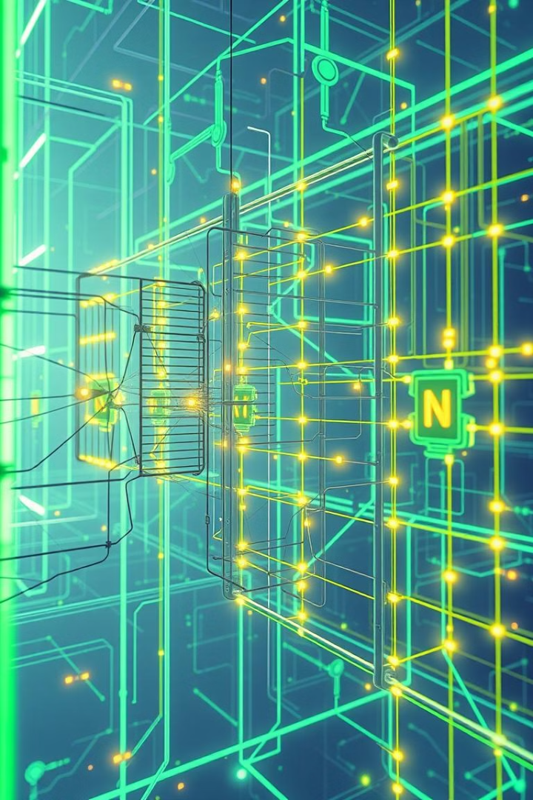



Deep Learning Architectures for OCR
Convolutional Neural Networks (CNNs) excel at feature extraction. Recurrent Neural Networks (RNNs) process sequential data like text. Hybrid models combine CNNs and RNNs for enhanced accuracy.
CNNs
Extract spatial features.
RNNs
Process sequences.
Hybrid Models
Combine CNNs and RNNs.

Slide 4
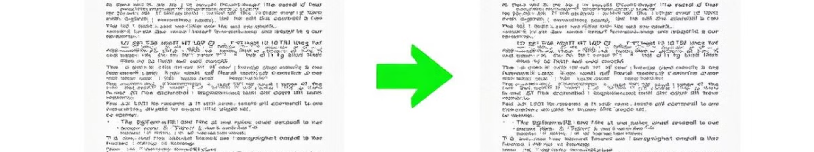
Preprocessing Techniques for Optimal Performance
Image enhancement reduces noise and improves contrast. Skew correction aligns text for accurate recognition. Segmentation isolates individual characters or words.
Image Enhancement
Skew Correction
Segmentation
Reduces noise and enhances contrast.
Aligns text properly.
Isolates characters and words.

Slide 5
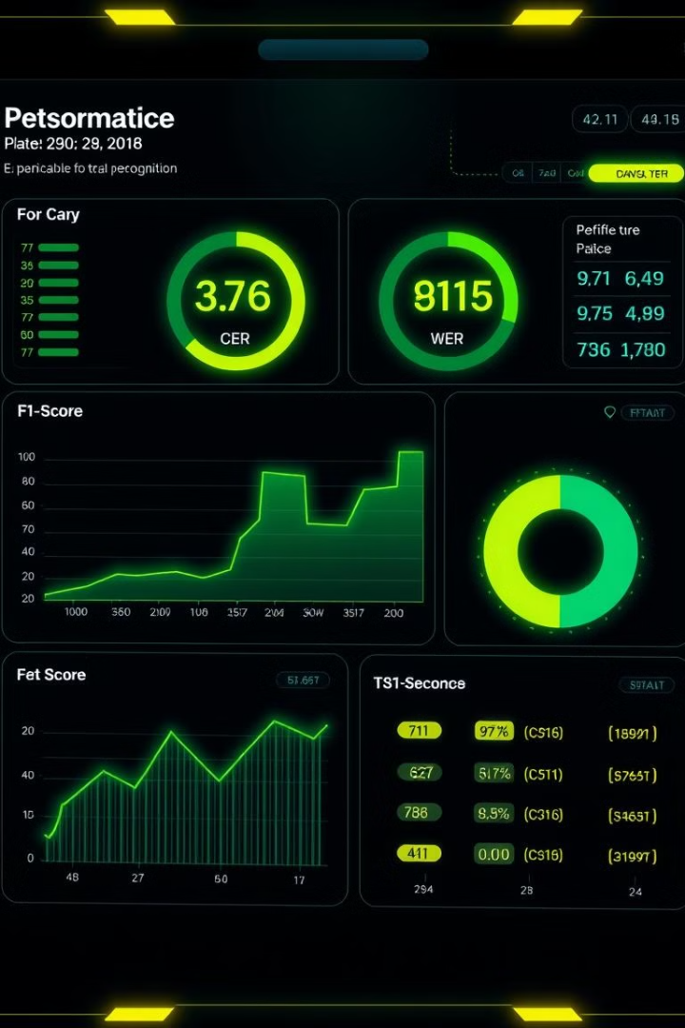
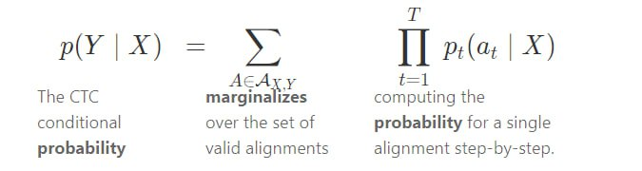
Training and Evaluation Metrics Explained
Character Error Rate (CER) measures the percentage of incorrect characters. Word Error Rate (WER) measures the percentage of incorrect words. F1-score balances precision and recall.

Slide 6
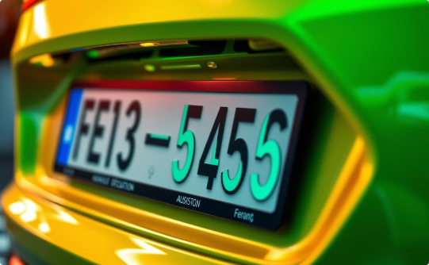
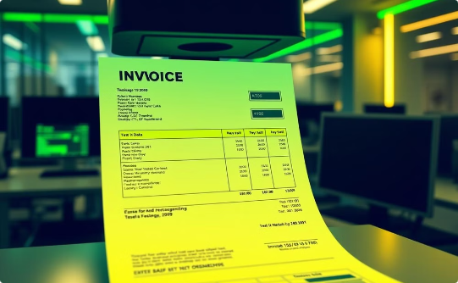
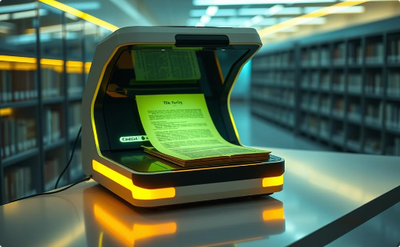
Case Studies: Real-World Applications
License plate recognition for automated toll collection. Invoice processing for efficient accounting. Digitizing historical documents for preservation. Deep learning improves accuracy.
License Plates
Invoices
Historical Documents
Automated toll collection.
Efficient accounting.
Preservation efforts.

Slide 7
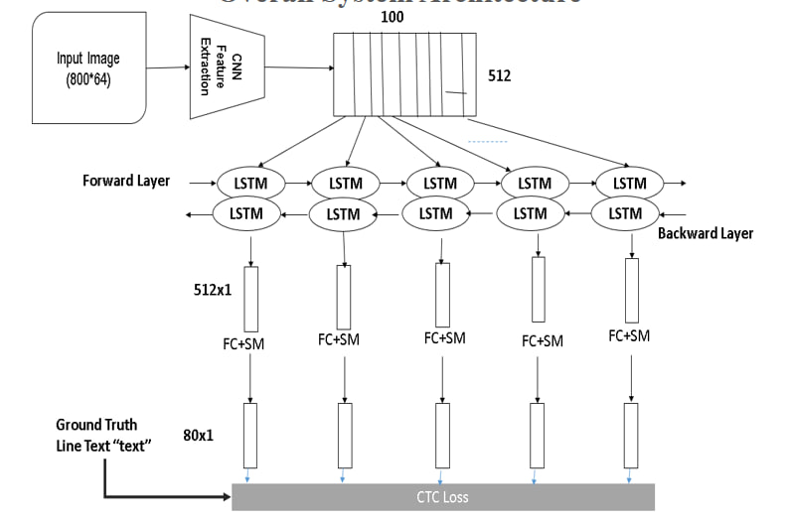
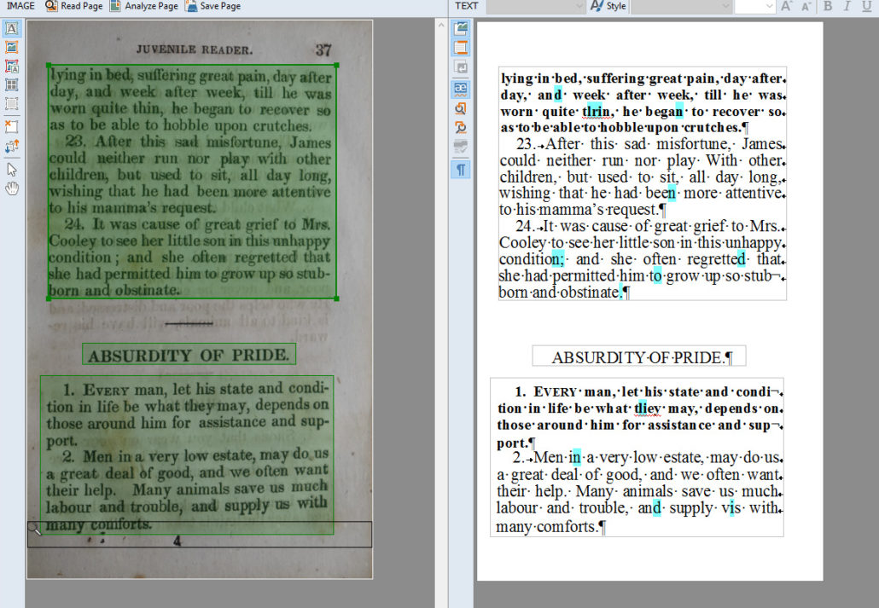
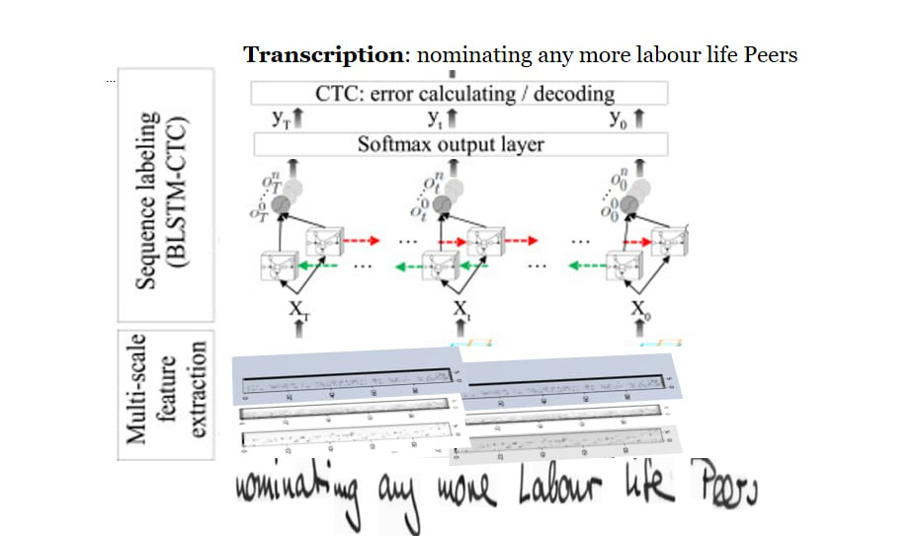

Slide 8
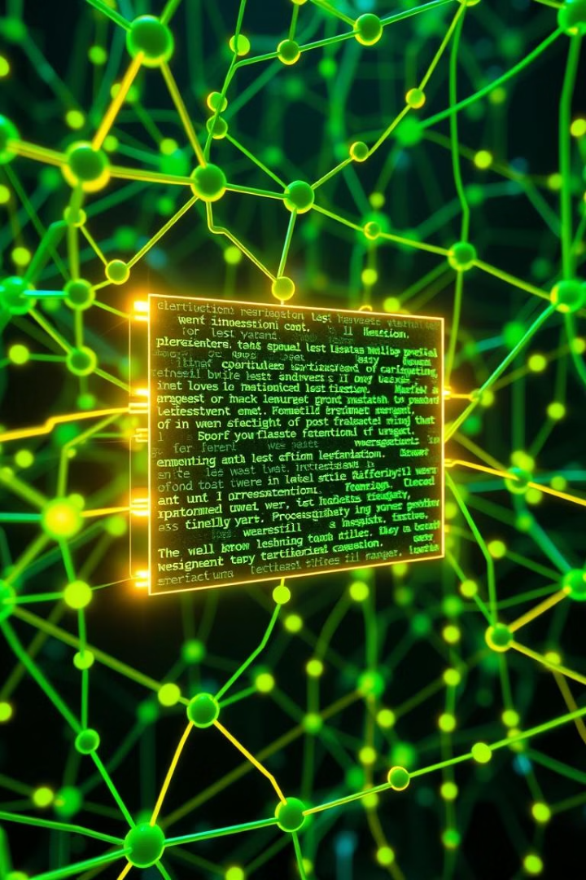
Challenges and Future Directions
Handling low-quality images is a persistent challenge. Adapting to diverse fonts and languages requires more data. Research focuses on unsupervised learning to reduce annotation needs.
1
Low-Quality Images
Noise and distortions.
2
Font Diversity
Adapting to new styles.
3
Unsupervised Learning
Reducing annotation.

Slide 9

Key Takeaways and Q&A
Deep learning significantly enhances text recognition. Preprocessing is crucial for optimal results. Real-world applications are transforming industries. The field continues to evolve.
1
Deep Learning
Enhances text recognition.
2
Preprocessing
Crucial for results.
3
Real-World Applications
Transform industries.
4
Evolving Field
Continues to evolve.

